Slide 1

Romanian Testing Conference 2018 Report
Ivana Maleš Galić, Span

Slide 2

We’ll talk about...
Intro
how to travel from Zagreb and Osijek to Cluj-Napoca?
3 days package (2 workshops&conference day)
Selecting the right workshops and sessions&preparing for workshops
Xtestathon = An extreme software testing challenge
Lectures
The Reality of Testing in an Artificial World
Did RTC 2018 meet my expectations?

Slide 3




Slide 4
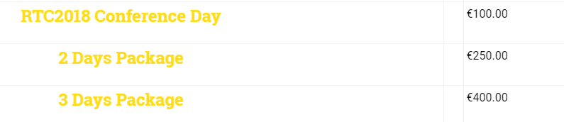
Conference Ticket
Selecting workshops and sessions (https://romaniatesting.ro/program/ ) -> COME PREPARED:
Read, Explore, Google Speakers and research available resources !!!
Preparing for workshops (e.g. https://github.com/angiejones/automation-bookstore )

Slide 5

The Reality of Testing in an Artificial World by Angie Jones http://angiejones.tech/ PPT: slides

Slide 6
Our world is changing...
Artificial intelligence is being employed in nearly every walk of life, from virtual assistants to self-driving cars.
? How will this new way of life impact software testing?
? What will be our role?
? Will there even be a need for software testers?
? What skills will testers need to know for testing AI-based technologies?
Notes:
You get the picture.

Slide 7
The Future of Testing...
Machine learning won't necessarily eliminate testing jobs, but it will change how the work gets done.
~Paul Merrill
We believe that the most important solution to overcome increasing testing challenges will be the emerging introduction of machine-based intelligence.
~2016-17 World Quality Report
We'll see a trend where humans will have less and less mechanical dirty work to do with implementing, executing, and analyzing test results but they will still be an integral and necessary part of the test process to approve and act on the findings.
~Moshe Milman & Adam Carmi
Notes:
You get the picture.

Slide 8
When talking about AI in testing community...
most of the discussion has been on how AI tools will be able to help us as a Testers
There are a lot of new automation tools that are popping up and promising that AI will save the day and that's all right
Going beyond conversations about tools => discussing how to test forms of AI that are present today in today's applications such as machine learning
Notes:
You get the picture.

Slide 9
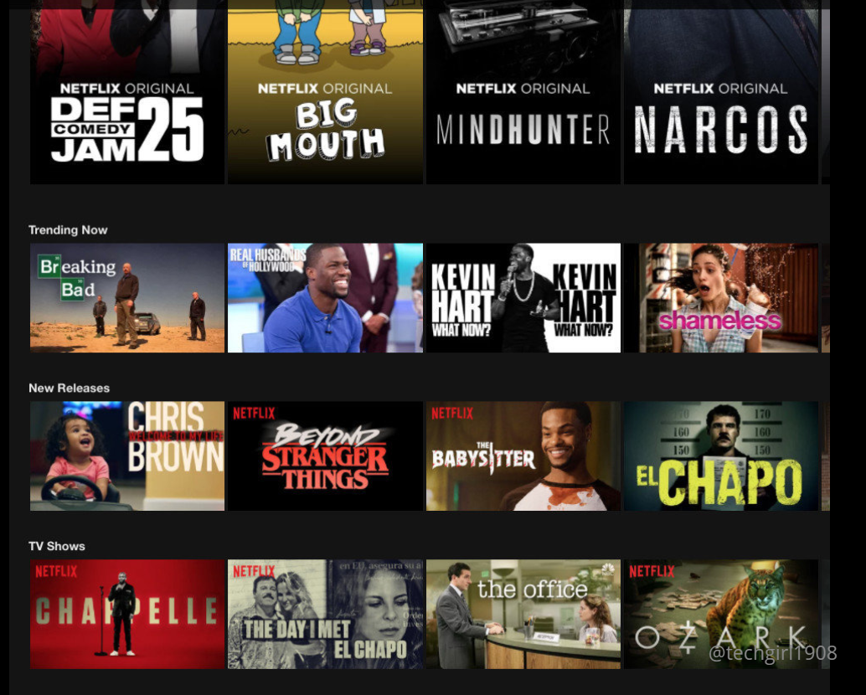
#Example: Netflix, Twitter
Q1: How to test this?
Q2: How to say if it’s correctly filtered?
Q3: How to tell if something is a bug?
Notes:
You get the picture.

Slide 10
#Example: Netflix, Twitter
How to test an application where it's core functionality is -> it has machine learning.
Netflix has its recommendation system: when you go to your opening page on Netflix the recommendations there are based on you personally -> that is also based on machine learning algorithms.
At Twitter there are features there that are employing machine learning. How to test if something is a spam?
Ask yourself...
Why do we look at AI, machine learning, as it is something that's way out in the future and not necessarily something we have to work on right now or think about right now.
Notes:
You get the picture.

Slide 11
Be ready, Get involved!
A lot of people will say there is no need to test machine learning features
What is Angie Jones advice?
„We should definitely be involved in this because people look at machine learning and AI concepts.
This black box that is always right, is just correct by default. And there have been horrific stories in the media where that is not the case.”
Notes:
You get the picture.

Slide 12
Machine etics – Trolly problem
http://angiejones.tech/wp-content/uploads/2018/03/The_ethics_of_self-driving_cars_-_Paul_Fenwick.mp4
Notes:
You get the picture.

Slide 13
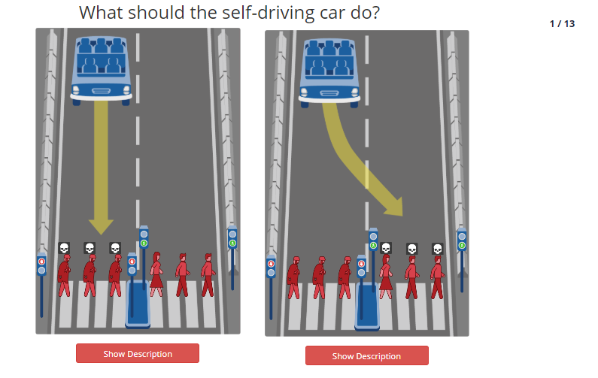
Moral Machine – solving moral dilemmas
http://moralmachine.mit.edu/
Notes:
You get the picture.

Slide 14
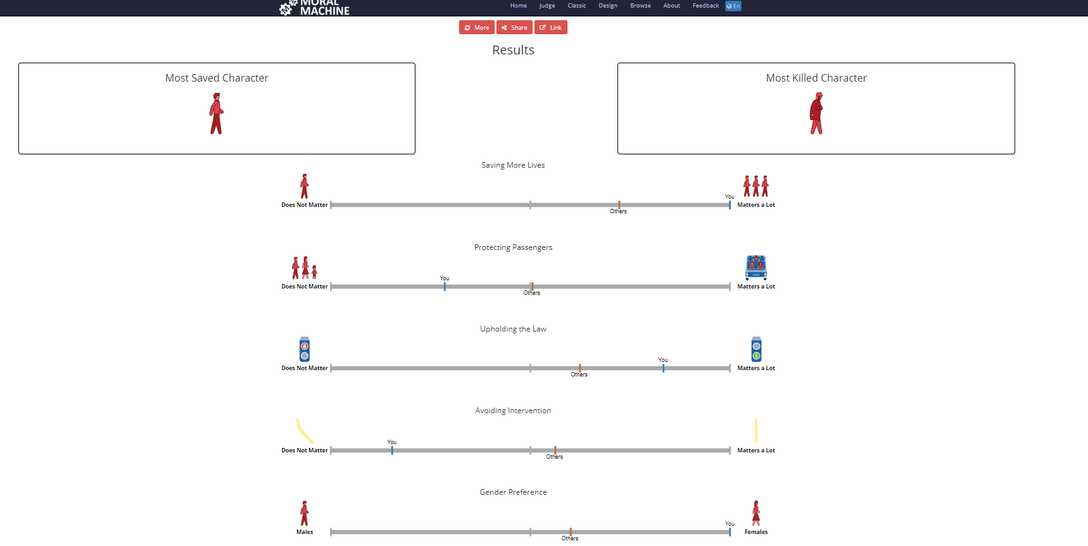
Moral Machine – solving moral dilemmas
Notes:
You get the picture.

Slide 15
Expect the unexpected...
What is your input for testing AI, ML app?
You expect your app to work better as time goes on – IT LEARNS!
What are the challenges in our guidelines for testing and automation?
we often say that in order to test such an order for it to be testable the exact results must be known in advance and especially for automation.
when you think about writing automation script you have this scenario in mind and you have an expected result and you need to assert on an expected result.
Problem?
in machine learning there is no exactness there is no preciseness. There's a range of possibilities that are valid and that could be correct.
Notes:
You get the picture.

Slide 16
What can we do?
Don't allow others to make you believe that AI and machine learning is this all-knowing black box. As testers we know better!
Get involved!
Read up more about what machine learning actually is
Look at different applications that are used in machine learning and start thinking about even if you don't work on them right now.
Ask yourself - How would I test this?
First step is to just start thinking about what would your test strategy be on something like a Netflix recommendations page or Twitters timeline of tweets, for example, like how would you test this.
Notes:
You get the picture.

Slide 17
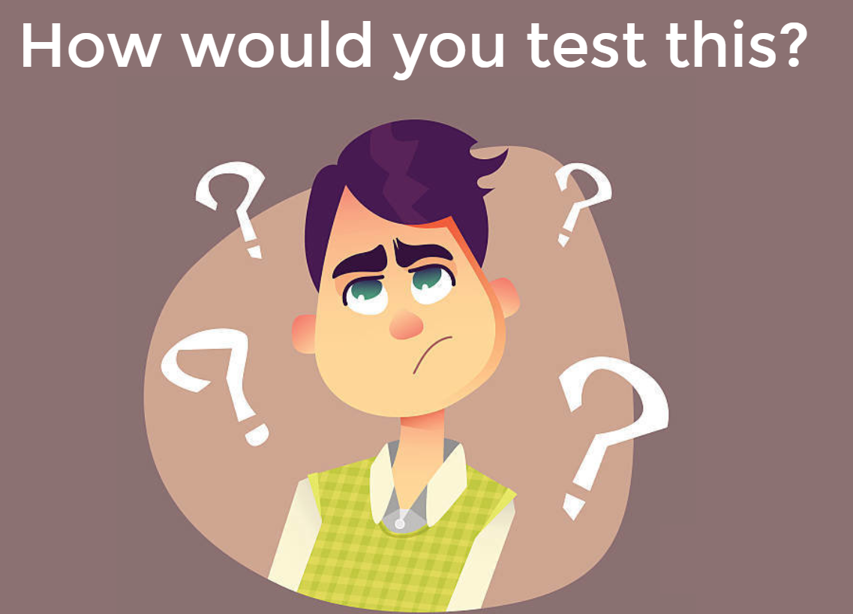

Notes:
You get the picture.

Slide 18
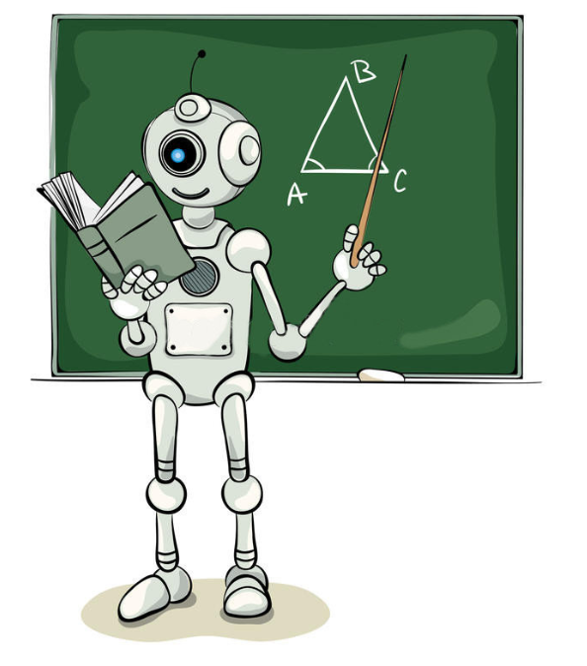
#1 Learn how it learns
There is no exact
RIGHT or WRONG answer

Slide 19

#2 Train the system
If the system hasn’t learned anything yet, it would randomly offer advertisements.
What would I like this system to learn?
e.g. Men like pants, women like dresses?

Slide 20
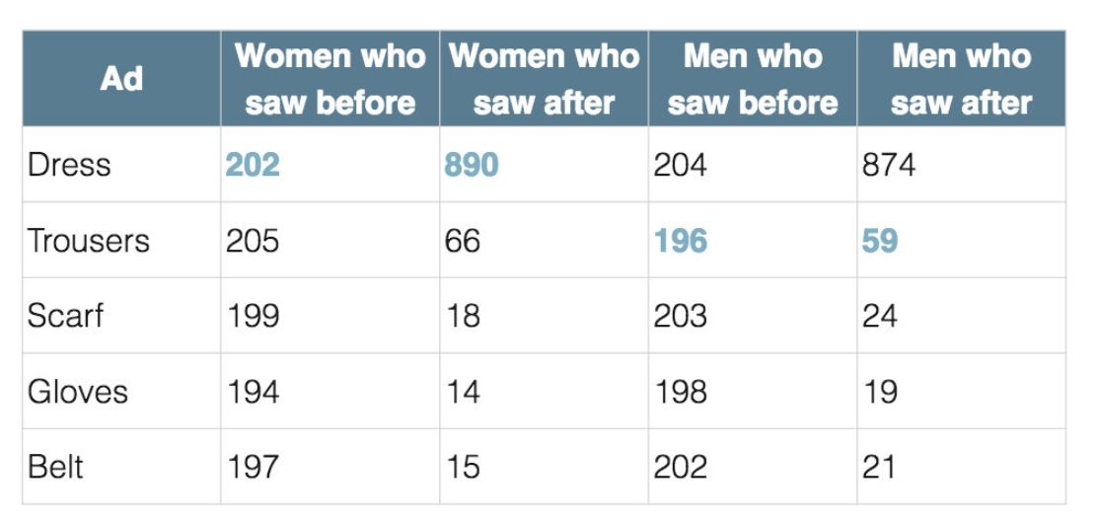

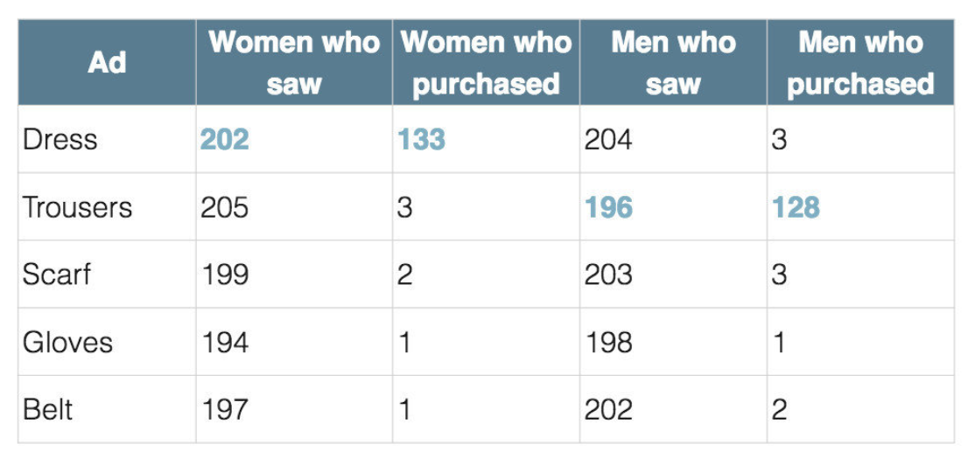
#2 Train the system

Slide 21
#2 Train the system
What was the problem?
= System displayed adds with products which sold most to all customers!!
Solution?
#1 Throw models!
#2 Give system more data – TO LEARN!

Slide 22
#3 Prove the Findings
As technology advances, so must our test approaches
Challenge your thoughts and beliefs
The need for automation became more apparent

Slide 23
CONCLUSION
There will always be a need for thoughtful and critical testing
Common sense can still trump an algorithm
What is my job as a tester?
Understanding what we think we are providing and we are actually doing – advocate for the customer, explain the impact
Security
Privacy
Ethics

Slide 24

Conference Buddy
Conference Buddy wants to provide a place to find companions for tech conferences. You can look for one or more person with whom you can attend a conference together. Support each other, find a familiar face between all these strangers. You will feel more at ease and comfortable just knowing you’re not alone. At the same time you’ll help others to feel better!
http://www.conferencebuddy.io/

Slide 25

VISIT TESTBASH
USE TWITTER
FIND A MENTOR
READ ARTICLES
PREPARE FOR CONF. DAY – CHOOSE YOUR SESSIONS
WISELY
WHO TO FOLLOW FROM QA WORLD?
(LINKEDIN, TWITTER)

Slide 26

Thanks!
Any questions?
You can find me at:
ivana.malesgalic@span.eu

